Slide 1
Statistics
Saravana

Slide 2
Statistics
What is Statistics?
Importance of Statistics?
Use of Statistics?
Branches of Statistics?
Independent & Dependent Variables
Categorical & Continuous Variables
Distributions
Skewness & Kurtosis

Slide 3
Relationship Between Variables
Variance
Standard Deviation
Scatter Plot
Co-Variance
Pearson –r (Correlation Coefficient)
Non-Linear Relationship
Co-relation & Causation

Slide 4
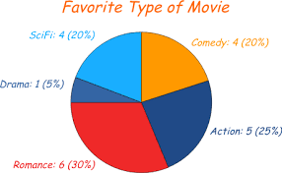
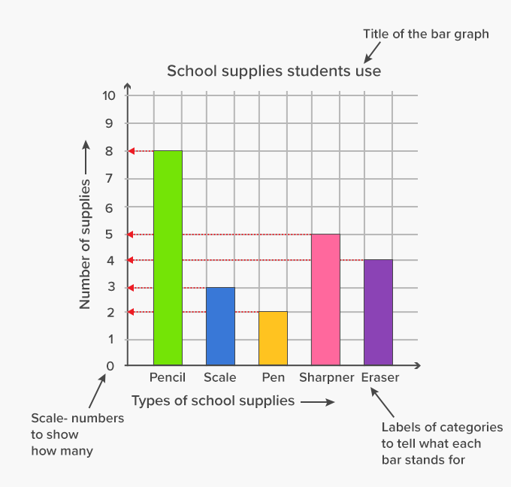
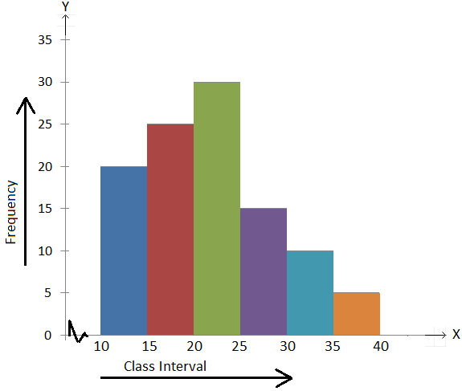
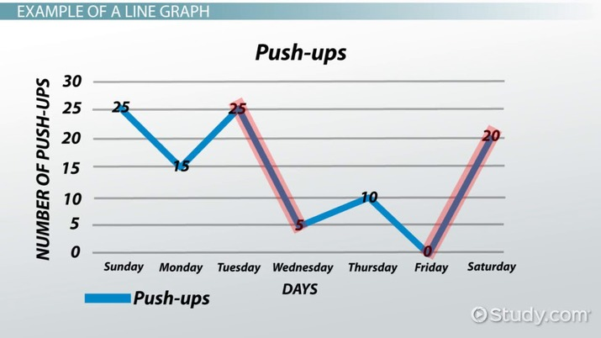
Statistical Graph
Histograms
Pie Chart
Line Graph
Bar Graph
Scatter Plot
Stem & Leaf Plot

Slide 5
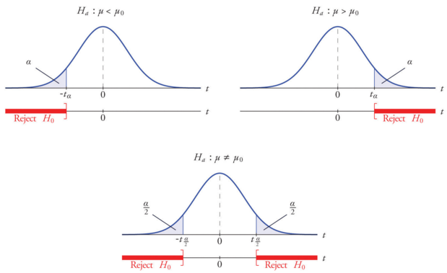
Statistical Test
Statistical tests are carried out extensively in psychology, medicine, nursing and business.

Slide 6
Types of Statistical Tests
Correlational | These tests look for an association between variables
Pearson correlation | Tests for the strength of the association between two continuous variables
One Sample Z-Test | Tests for association between the sample & the population
One Sample T-Test | Tests for association between the sample & the population when the sample size is small or when the population sd is unknown
Paired Z-test | Tests for the difference between two related variables
Paired T-test | Tests for the difference between two related variables (when the sample size is small)
Independent Z-test | Tests for the difference between two independent variables
Independent T-test | Tests for the difference between two independent variables (When the sample size is small)
ANOVA | Tests the difference between group means after any other variance in the outcome variable is accounted for
Chi-Square Test | Test is used to compare categorical variables

Slide 7
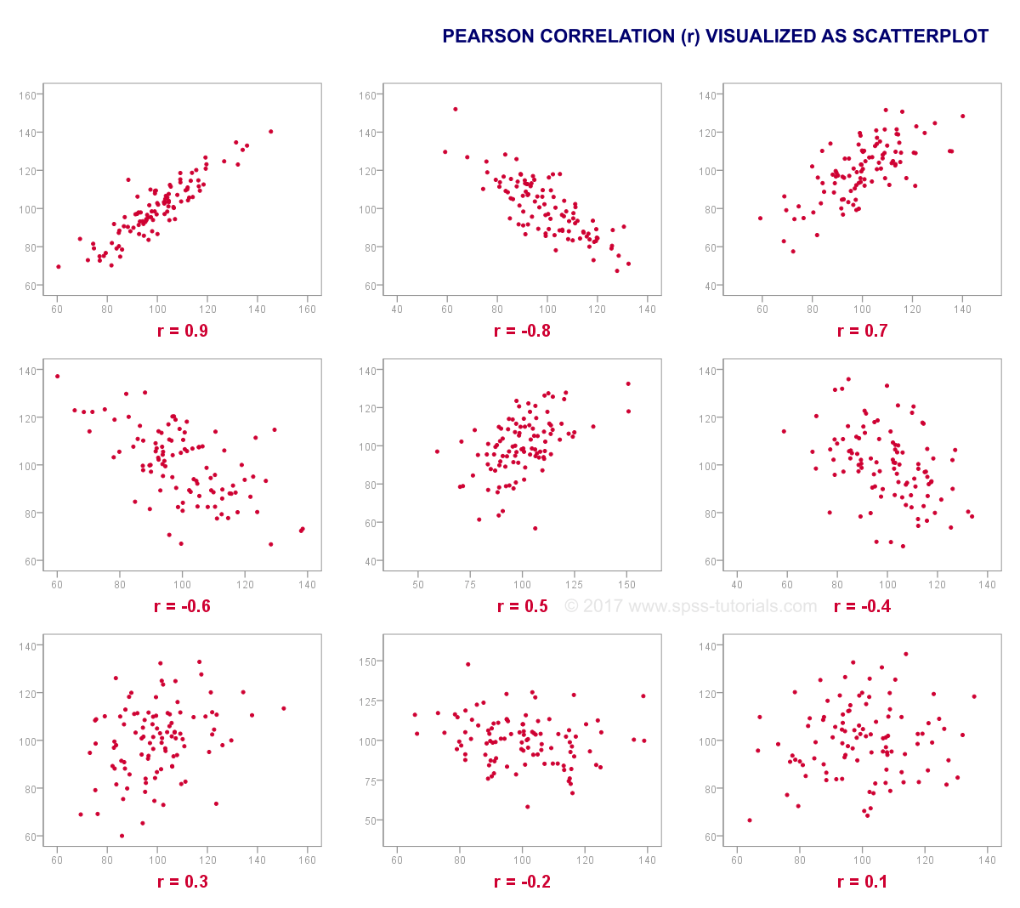
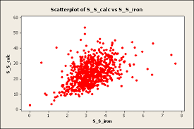

Slide 8
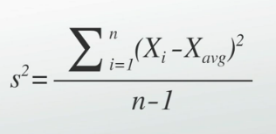
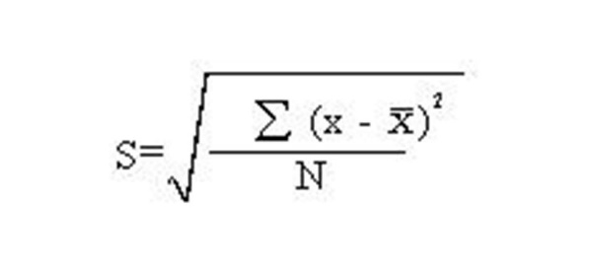
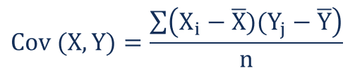
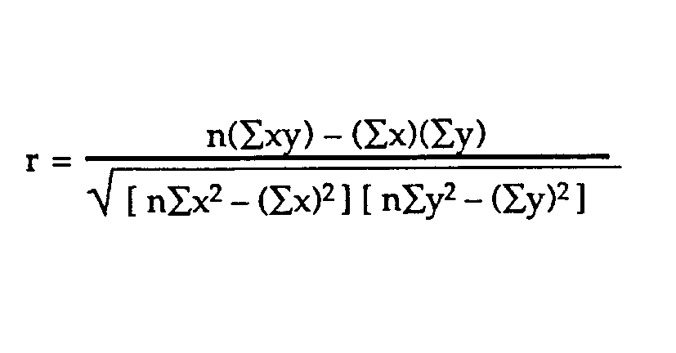
Formulas
Variance
Standard Deviation
Covariance
Pearson-r

Slide 9
Z & T Test
Testing if the Sample of Cholesterol levels in 2019 in statistically different than 200 mg?
A Principle at a School claims that the student in SSC in his school are above average intelligence.
“Do pupils’ grades improve after they receive tutoring?”
Did the weight loss program help the society?.
The Mayor of a Town saw an article which says unemployment rate is 8%, he wondered if its true for his town.
A Company claims that the Age group in one branch is Less than the Age Group of the whole company.
There are More Females than males, taking part in this Completion.
Z Table

Slide 10
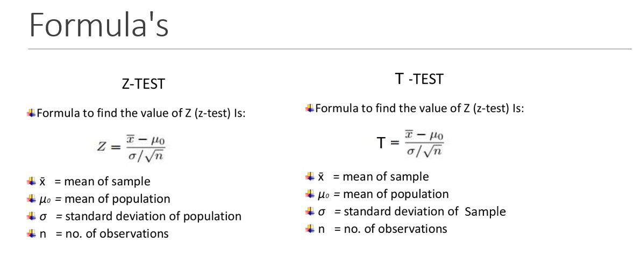

Slide 11
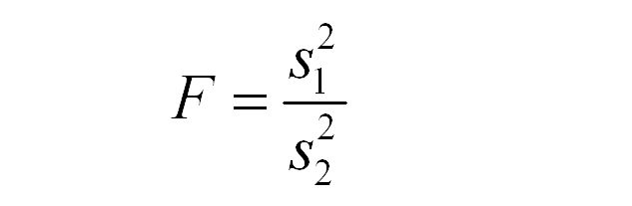
F Test
Its Used to Compare Two Variances
Z-statistic or t-statistic, where we deal with mean & proportion, Chi-square or F-test is used for finding out whether there is any variance within the samples
If our calculated F value in a test is larger than our F statistic, We can reject the null hypothesis.
One Tailed F-Test
Variance from the first population is either greater than or less than (but not both) the second population variance
Two Tailed F-Test
We just want to know if the variances are not equal to each other
F Table

Slide 12
ANOVA (Analysis of Variance)
In Analysis of variance, you’re testing groups to see if there’s a difference between them.
A group of psychiatric patients are trying three different therapies: Counselling, Medication ,Biofeedback.
A manufacturer has two different processes to make light bulbs. They want to know if one process is better than the other.
Students from different colleges take the same exam. You want to see if one college outperforms the other.

Slide 13
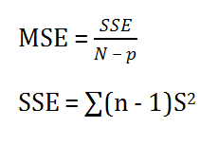
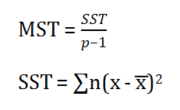

ANOVA in Simple Terms
ANOVA is used to compare differences of means among more than 2 groups. It does this by looking at variation in the data and where that variation is found (hence its name). Specifically, ANOVA compares the amount of variation between groups with the amount of variation within groups
One way Anova test
SST = Sum of squares due to treatment p = Total number of populations n = The total number of samples in a population
Formula for MSE is given below:
SSE = Sum of squares due to error S = Standard deviation of the samples
F = Anova Coefficient MST = Mean sum of squares due to treatment MSE = Mean sum of squares due to error

Slide 14
ANOVA
One Way ANOVA
Used to Test If there’s any Statistically Significant differences between the means of two or more independent (unrelated) groups.
Two Way ANOVA
With a One Way, you have one independent variable affecting a dependent variable. With a Two Way ANOVA, there are two independents.

Slide 15
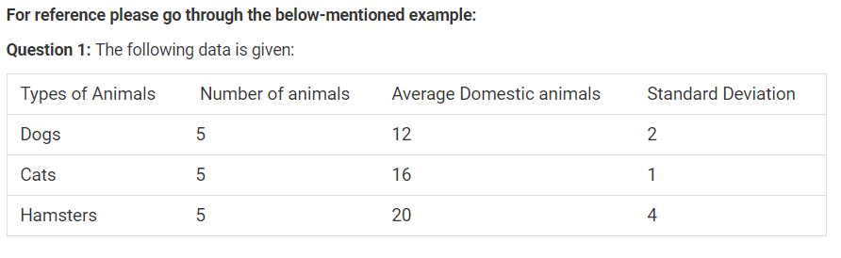
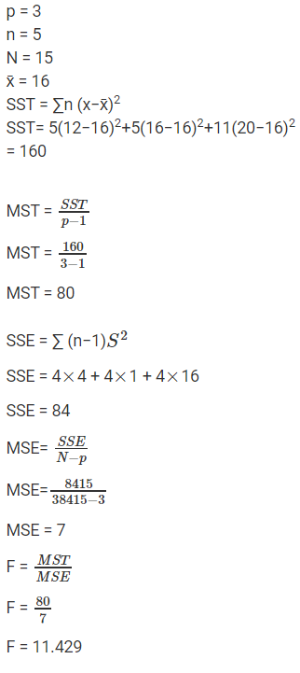
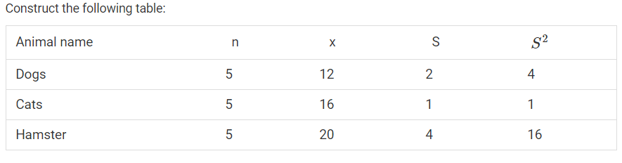
Example of ANOVA

Slide 16
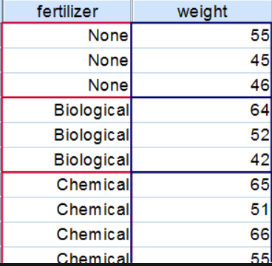
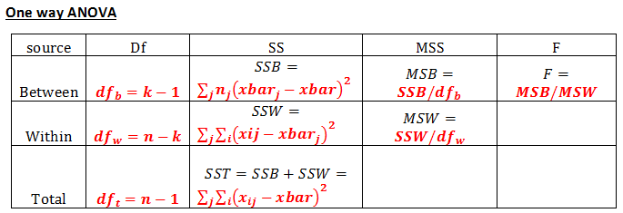
Examples

Slide 17
Two way ANOVA
Two Way ANOVA (without replication)
You’re testing one set of individuals before and after they take a medication to see if it works or not.
eg: - find out if there is an interaction between income and gender for anxiety level at job interviews
Two Way ANOVA (with replication)
Two groups of patients from different hospitals trying two different therapies

Slide 18
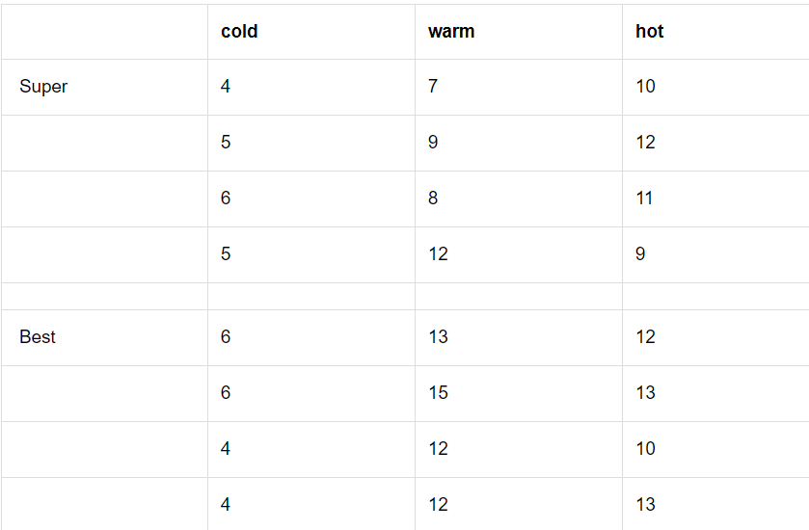
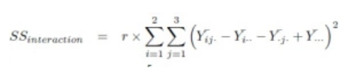
Examples
Suppose you want to determine whether the brand of laundry detergent used and the temperature affects the amount of dirt removed from your laundry.
MS(within) = SS(within)/df(within)
MS(Between) = SS(Between)/df(Between)
Calculate SS(interaction):
Calculate df(interaction): df(interaction) = (a-1)*(b-1)
Calculate MS(interaction): MS(interaction) = SS(interaction)/df(interaction)

Slide 19
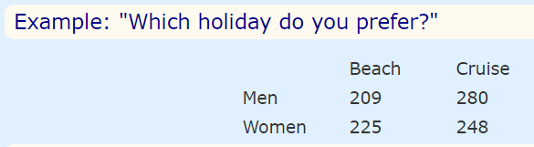
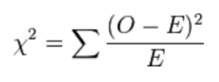
Chi-Square Test
Used for testing relationships between categorical variables
If Gender (Man or Woman) does affect Preferred Holiday we say they are dependent.
By doing some special calculations (explained later), we come up with a "p" value which is 0.132
Now, p < 0.05 is the usual test for dependence. In this case p is greater than 0.05, so we believe the variables are independent (ie not linked together).
In other words Men and Women probably do not have a different preference for Beach Holidays or Cruises.
Chi Square Table

Slide 20
Understanding "p" Value
"p" is the probability the variables are independent.
So most people want to see a p value less than 0.05 before they are happy to say the results show the groups have a different response.
Why p<0.05 ?
It is just a choice! Using p<0.05 is common, but we could have chosen p<0.01 to be even more sure that the groups behave differently, or any value really.

Slide 21
Assumptions
Normal Distributions
Independent Variables
Randomness

Slide 22
Why Do we have these tests
Are the samples or the sample and the population differ?
Is that just random chance or have you found something Interesting?

Slide 23
Key-Takeaways
When to Use Each Tests
Difference between T and Z Tests
Formula & Purpose of Each Tests
How to Test them in Python

